Slide 1


Presentation of the On-the-Job Training at DOrSU-DICT Office
ITP142 - Practicum

Slide 2

Contents
Introduction
Company/HTE Profile
OJT Outputs (Task and Responsibilities)
Pictorials
Challenges Encountered
Learning and Insights

Slide 3
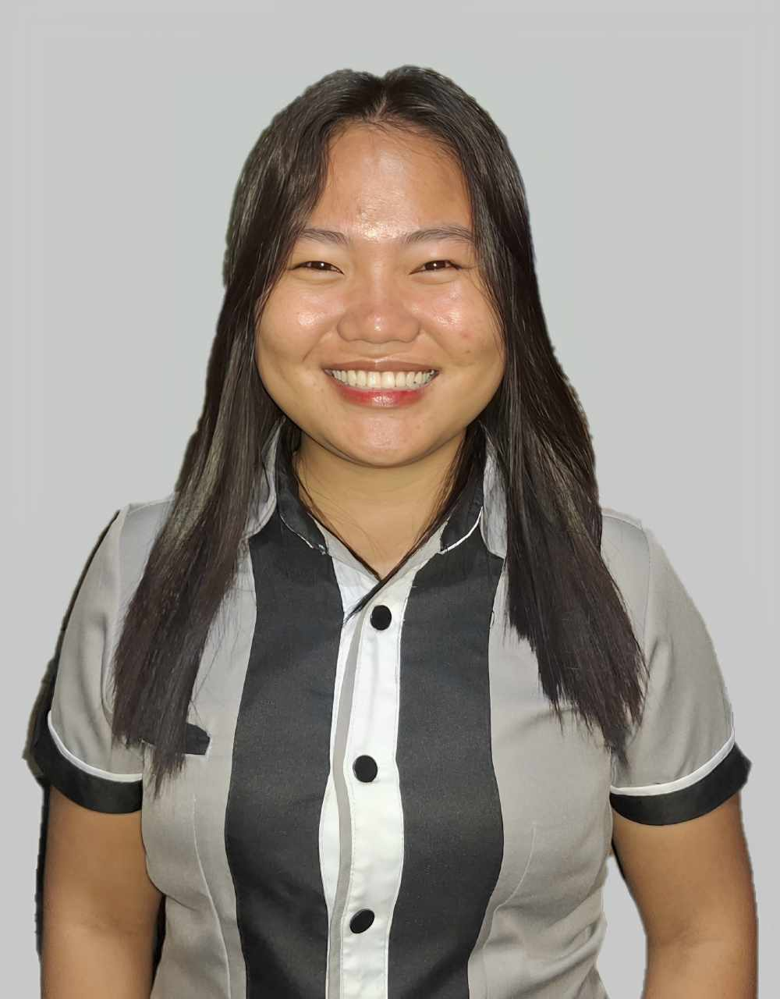
Introduction (per student, alphabetical)
Name: Mary Joy A. Antonio
Address: Prk. Malinawon, Damping, Matiao, Mati City
Course/Yr/Sec: BSIT4-A
In-campus HTE: DOrSU-PIA Office
Duration: Februry 6 – March 10, 2025 (136 hrs.)
Off-campus HTE: DOrSU-DICT Office
Duration: March 17 – May 20, 2025 (350 hrs.)

Slide 4
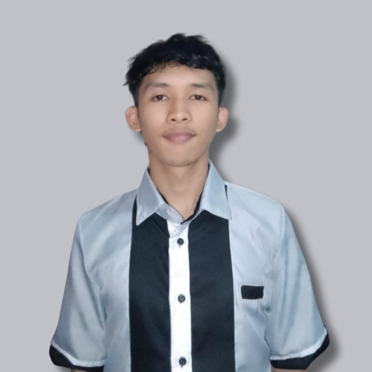
Introduction (per student, alphabetical)
Name: Angelo Allen Gabriel D. Aparicio
Address: LGR, Brgy. Central. Poblacion, Mati City, Davao Oriental
Course/Yr/Sec: BSIT4-C
In-campus HTE: DOrSU-DICT Office
Duration: February 6 – March 3, 2025 (136 hrs.)
Off-campus HTE: DOrSU-DICT Office
Duration: March 17 – May 20, 2025 (350 hrs.)

Slide 5
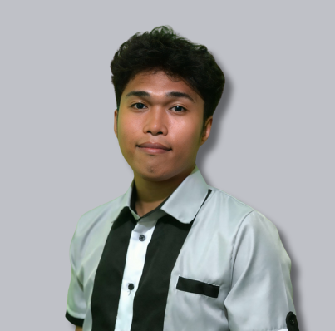
Introduction (per student, alphabetical)
Name: John Paul C. Colita
Address: Prk. Sampaguita, Interco, Matiao, Mati City, Davao Oriental
Course/Yr/Sec: BSIT4-B
In-campus HTE: DOrSU-DICT Office (ICTU)
Duration: Februry 6 – March 5, 2025 (136 hrs.)
Off-campus HTE: DOrSU-DICT Office (ICTU)
Duration: March 17 – May 28, 2025 (350 hrs.)

Slide 6
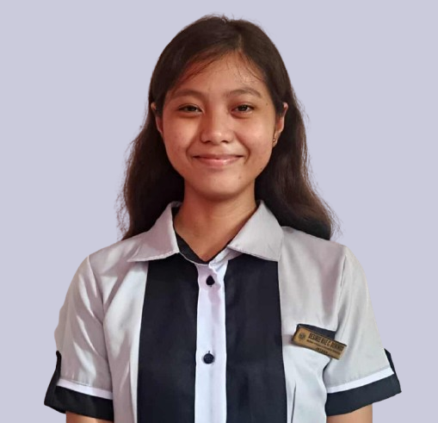
Introduction (per student, alphabetical)
Name: Desiree Mae C. Domingo
Address: Bilawan-2. Brgy. Central, Mati City, Davao Oriental
Course/Yr/Sec: BSIT4-C
In-campus HTE: DOrSU-DICT Office
Duration: February 6 – March 3, 2025 (136 hrs.)
Off-campus HTE: DOrSU-DICT Office
Duration: March 17 – May 20, 2025 (350 hrs.)

Slide 7
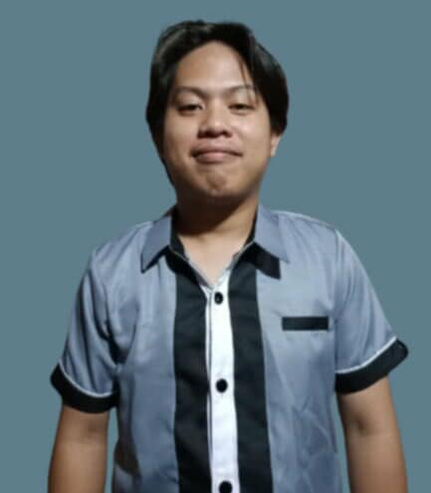
Introduction (per student, alphabetical)
Name: MJ M. Enriquez
Address: Prk. Hayahay, Poblacion, Lupon, Davao Oriental
Course/Yr/Sec: BSIT4-C
In-campus HTE: DOrSU-DICT Office
Duration: February 6 – March 3, 2025 (136 hrs.)
Off-campus HTE: DOrSU-DICT Office
Duration: March 17 – May 20, 2025 (350 hrs.)

Slide 8
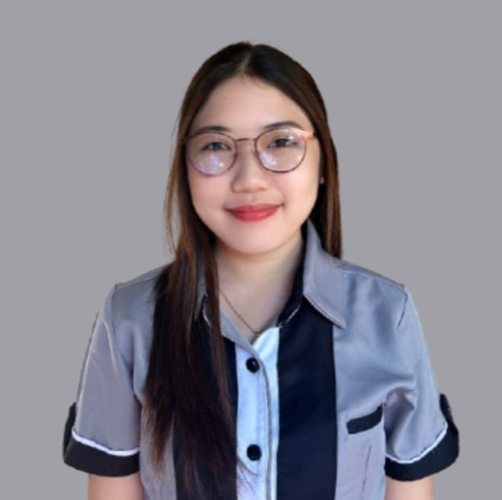
Introduction (per student, alphabetical)
Name: Marjuree M. Gayola
Address: Don Luis Village, Mati City, Davao Or.
Course/Yr/Sec: BSIT4-C
In-campus HTE: Office of Student Counseling and Development (OSCD)
Duration: February 6 – March 7, 2025 (136 hrs.)
Off-campus HTE: DOrSU-DICT Office
Duration: March 17 – May 26, 2025 (350 hrs.)

Slide 9
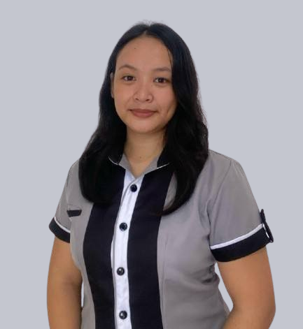
Introduction (per student, alphabetical)
Name: Jiah Mae O. Lawas
Address: Purok Malinawon-2, Camansi, Brgy. Badas, Mati City, Davao Or.
Course/Yr/Sec: BSIT4-A
In-campus HTE: Innovation Office
Duration: February 6 – March 3, 2025 (136 hrs.)
Off-campus HTE: DOrSU-DICT Office
Duration: March 17 – May 20, 2025 (350 hrs.)

Slide 10
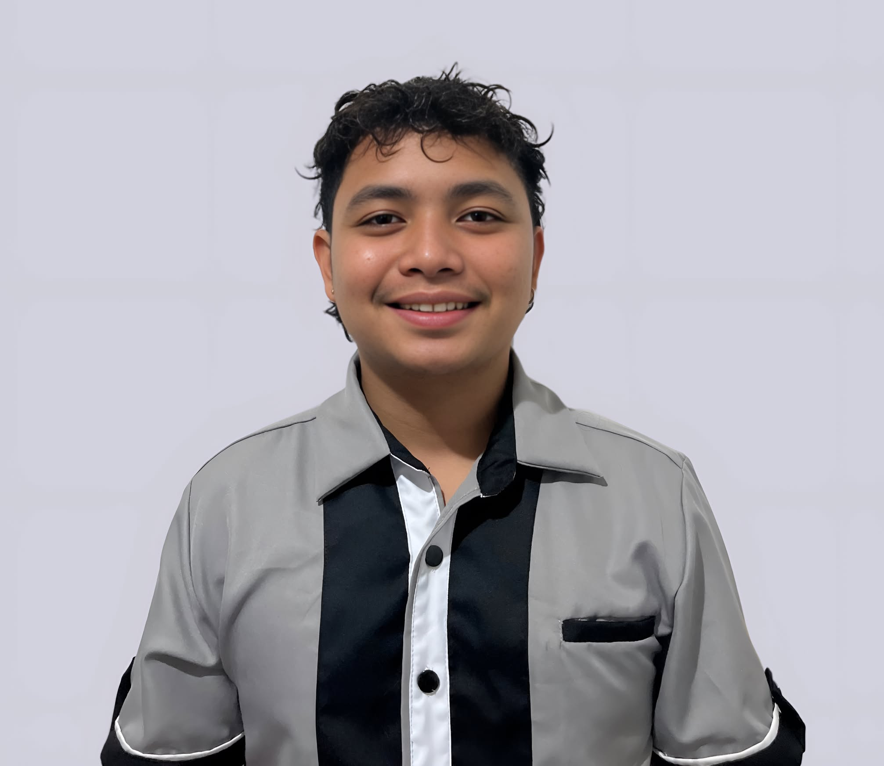
Introduction (per student, alphabetical)
Name: Jade Devon C. Lore
Address: Prk. Wagon, Brgy. Macambol, Mati City
Course/Yr/Sec: BSIT4-A
In-campus HTE: DOrSU-DICT Office (ICTU)
Duration: February 6 – March 3, 2025 (136 hrs.)
Off-campus HTE: DOrSU-DICT Office (ICTU)
Duration: March 17 – May 20, 2025 (350 hrs.)

Slide 11
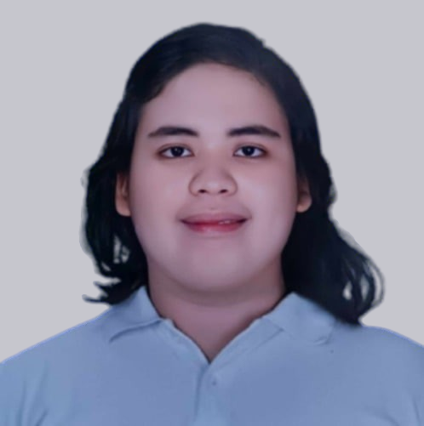
Introduction (per student, alphabetical)
Name: Leah Mantog
Address: Magsaysay 17-3, Mati City, Davao Or.
Course/Yr/Sec: BSIT4-A
In-campus HTE: DOrSU-DICT Office
Duration: March 21 – April 14, 2025 (136 hrs.)
Off-campus HTE: DOrSU-DICT Office
Duration: March 17 – May 20, 2025 (350 hrs.)

Slide 12
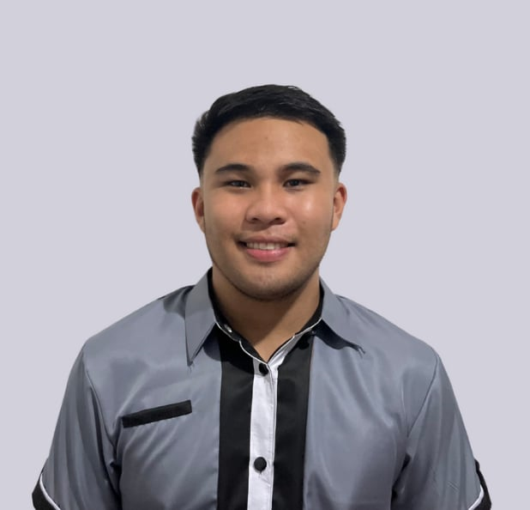
Introduction (per student, alphabetical)
Name: Kaarlo Ruy P. Sasiang
Address: Echavia, Matiao, Mati City
Course/Yr/Sec: BSIT4-A
In-campus HTE: DOrSU-DICT Office (ICTU)
Duration: February 6 – March 3, 2025 (136 hrs.)
Off-campus HTE: DOrSU-DICT Office (ICTU)
Duration: March 17 – May 20, 2025 (350 hrs.)

Slide 13
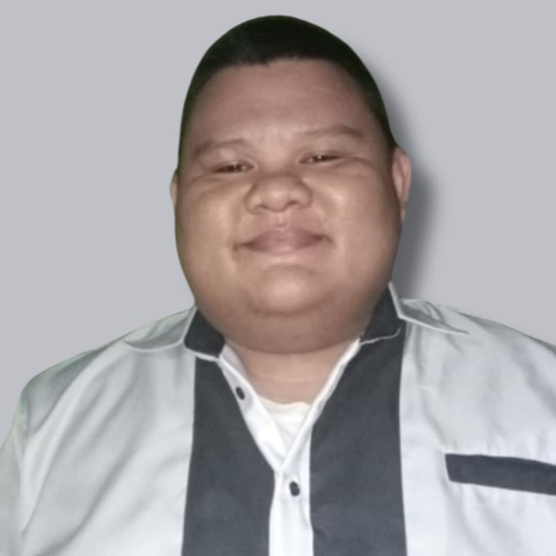
Introduction (per student, alphabetical)
Name: Kent Lee J. Superalez
Address: Prk. Kaislaman 17-4, Magsaysay, Mati City, Davao Or.
Course/Yr/Sec: BSIT4-C
In-campus HTE: DOrSU-DICT Office
Duration: February 6 – March 3, 2025 (136 hrs.)
Off-campus HTE: DOrSU-DICT Office
Duration: March 17 – May 20, 2025 (350 hrs.)

Slide 14
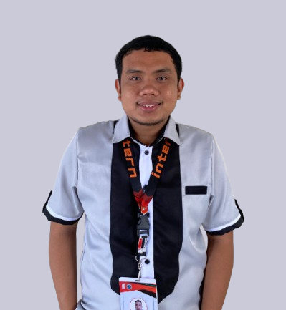
Introduction (per student, alphabetical)
Name: Ronel L. Venturina
Address: Conchita Ong Subdivision, Mati City. Dvo. Or.
Course/Yr/Sec: BSIT4-C
In-campus HTE: FTED DEAN Office
Duration: February 6 – March 5, 2025 (136 hrs.)
Off-campus HTE: DOrSU-DICT Office
Duration: March 17 – May 26, 2025 (350 hrs.)

Slide 15
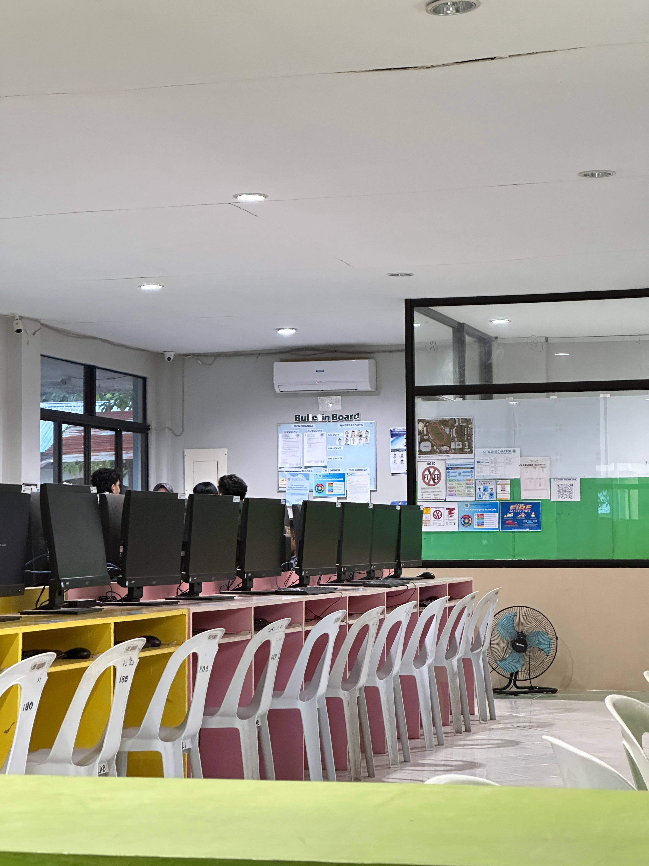
Company/HTE Profile (off-campus only)
Name of the HTE: DOrSU-DICT Office
Department Assigned To: IT Department
Name of Supervisor: Arnel Leo L. Aranquez
Nature of Business: IT Services
Location: Davao Oriental State University (DOrSU)

Slide 16
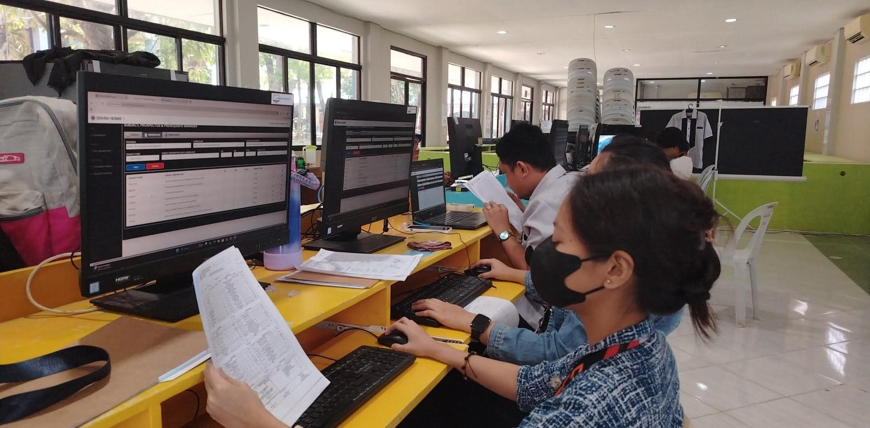
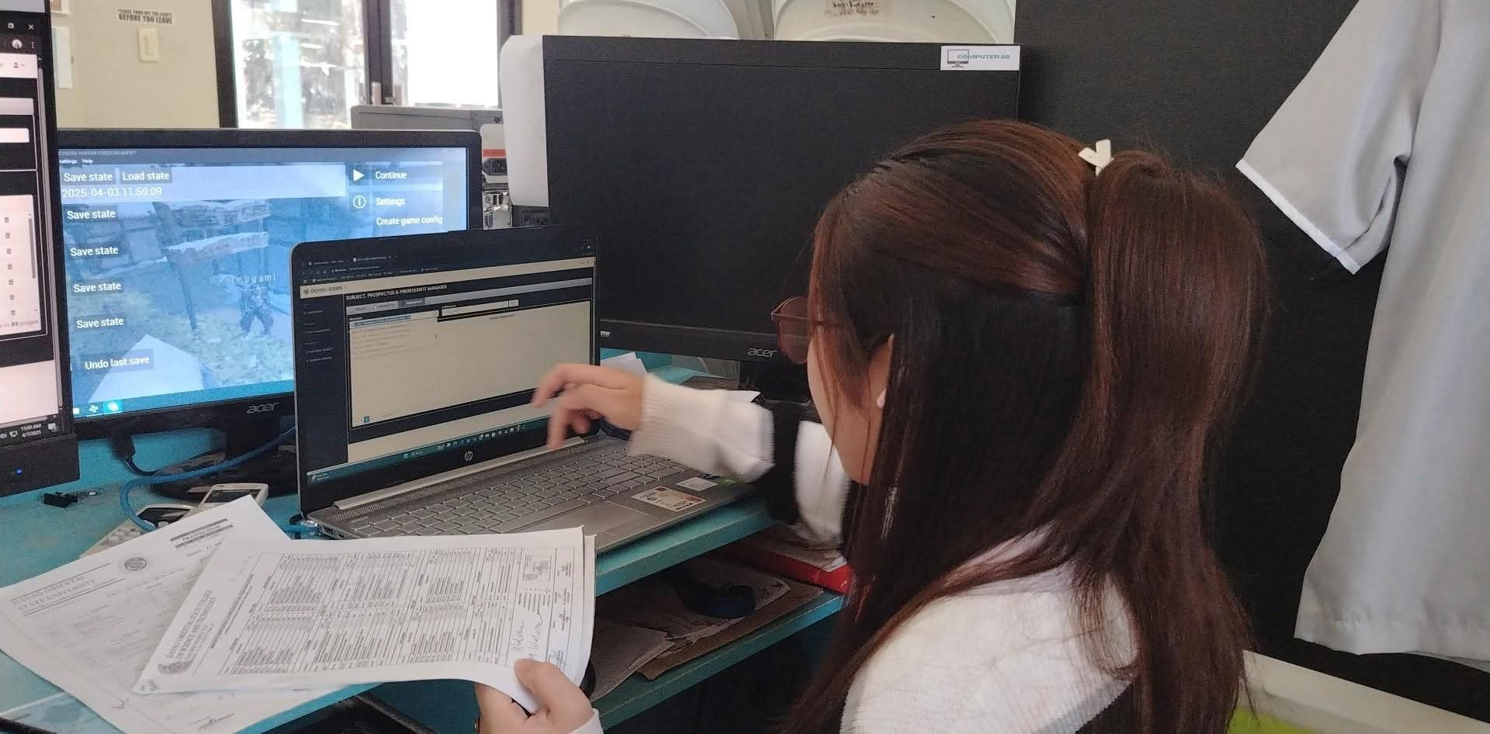
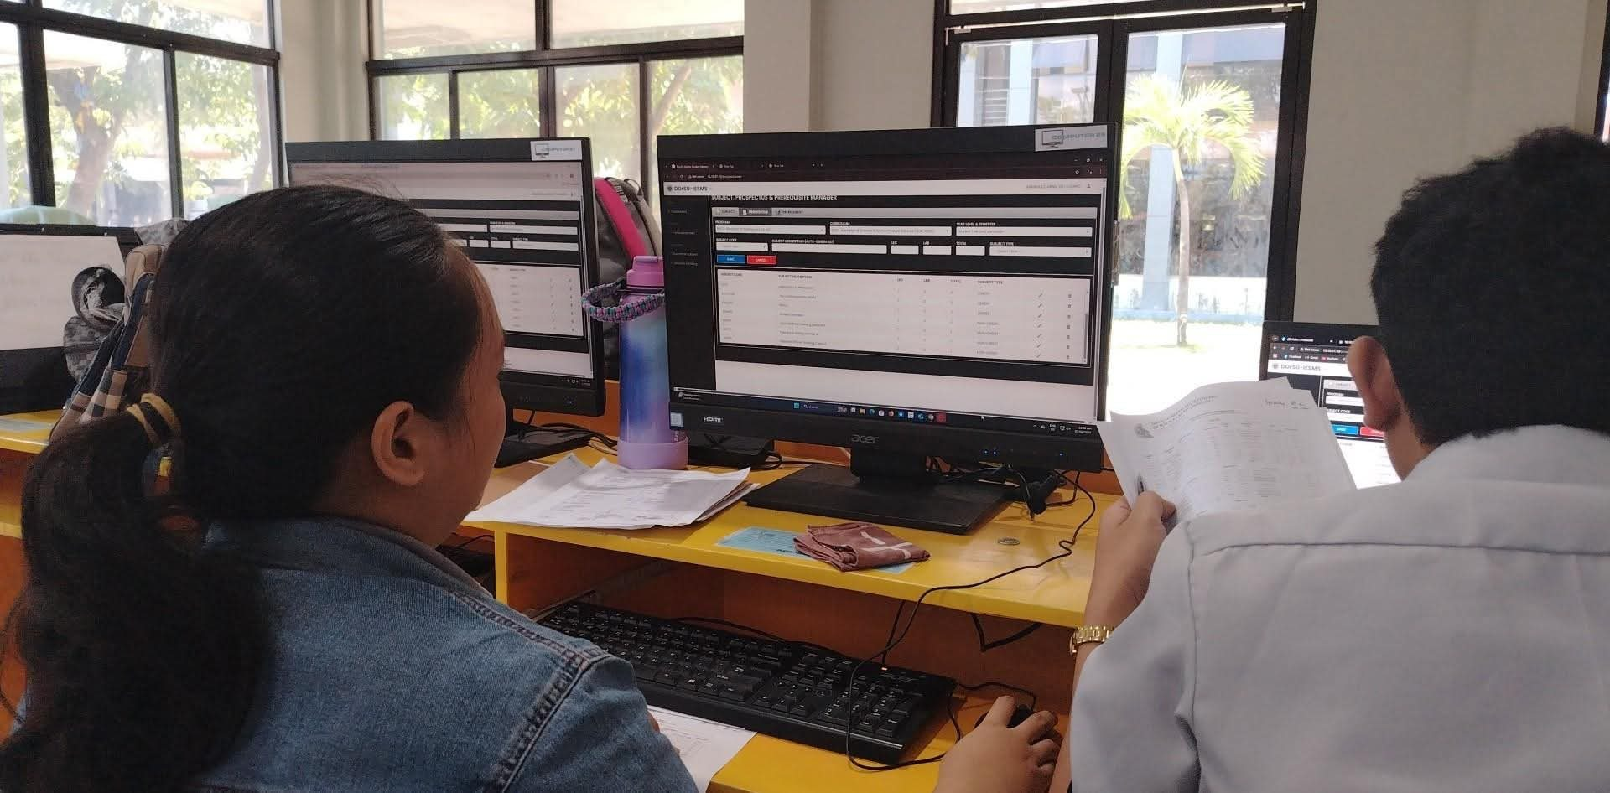
OJT Outputs (by group and individual)
We encode the prospectuses of all the different courses of DOrSU (including extension campuses) and other details in the ISMS. We also compute and encode the tuition fees of each courses.

Slide 17
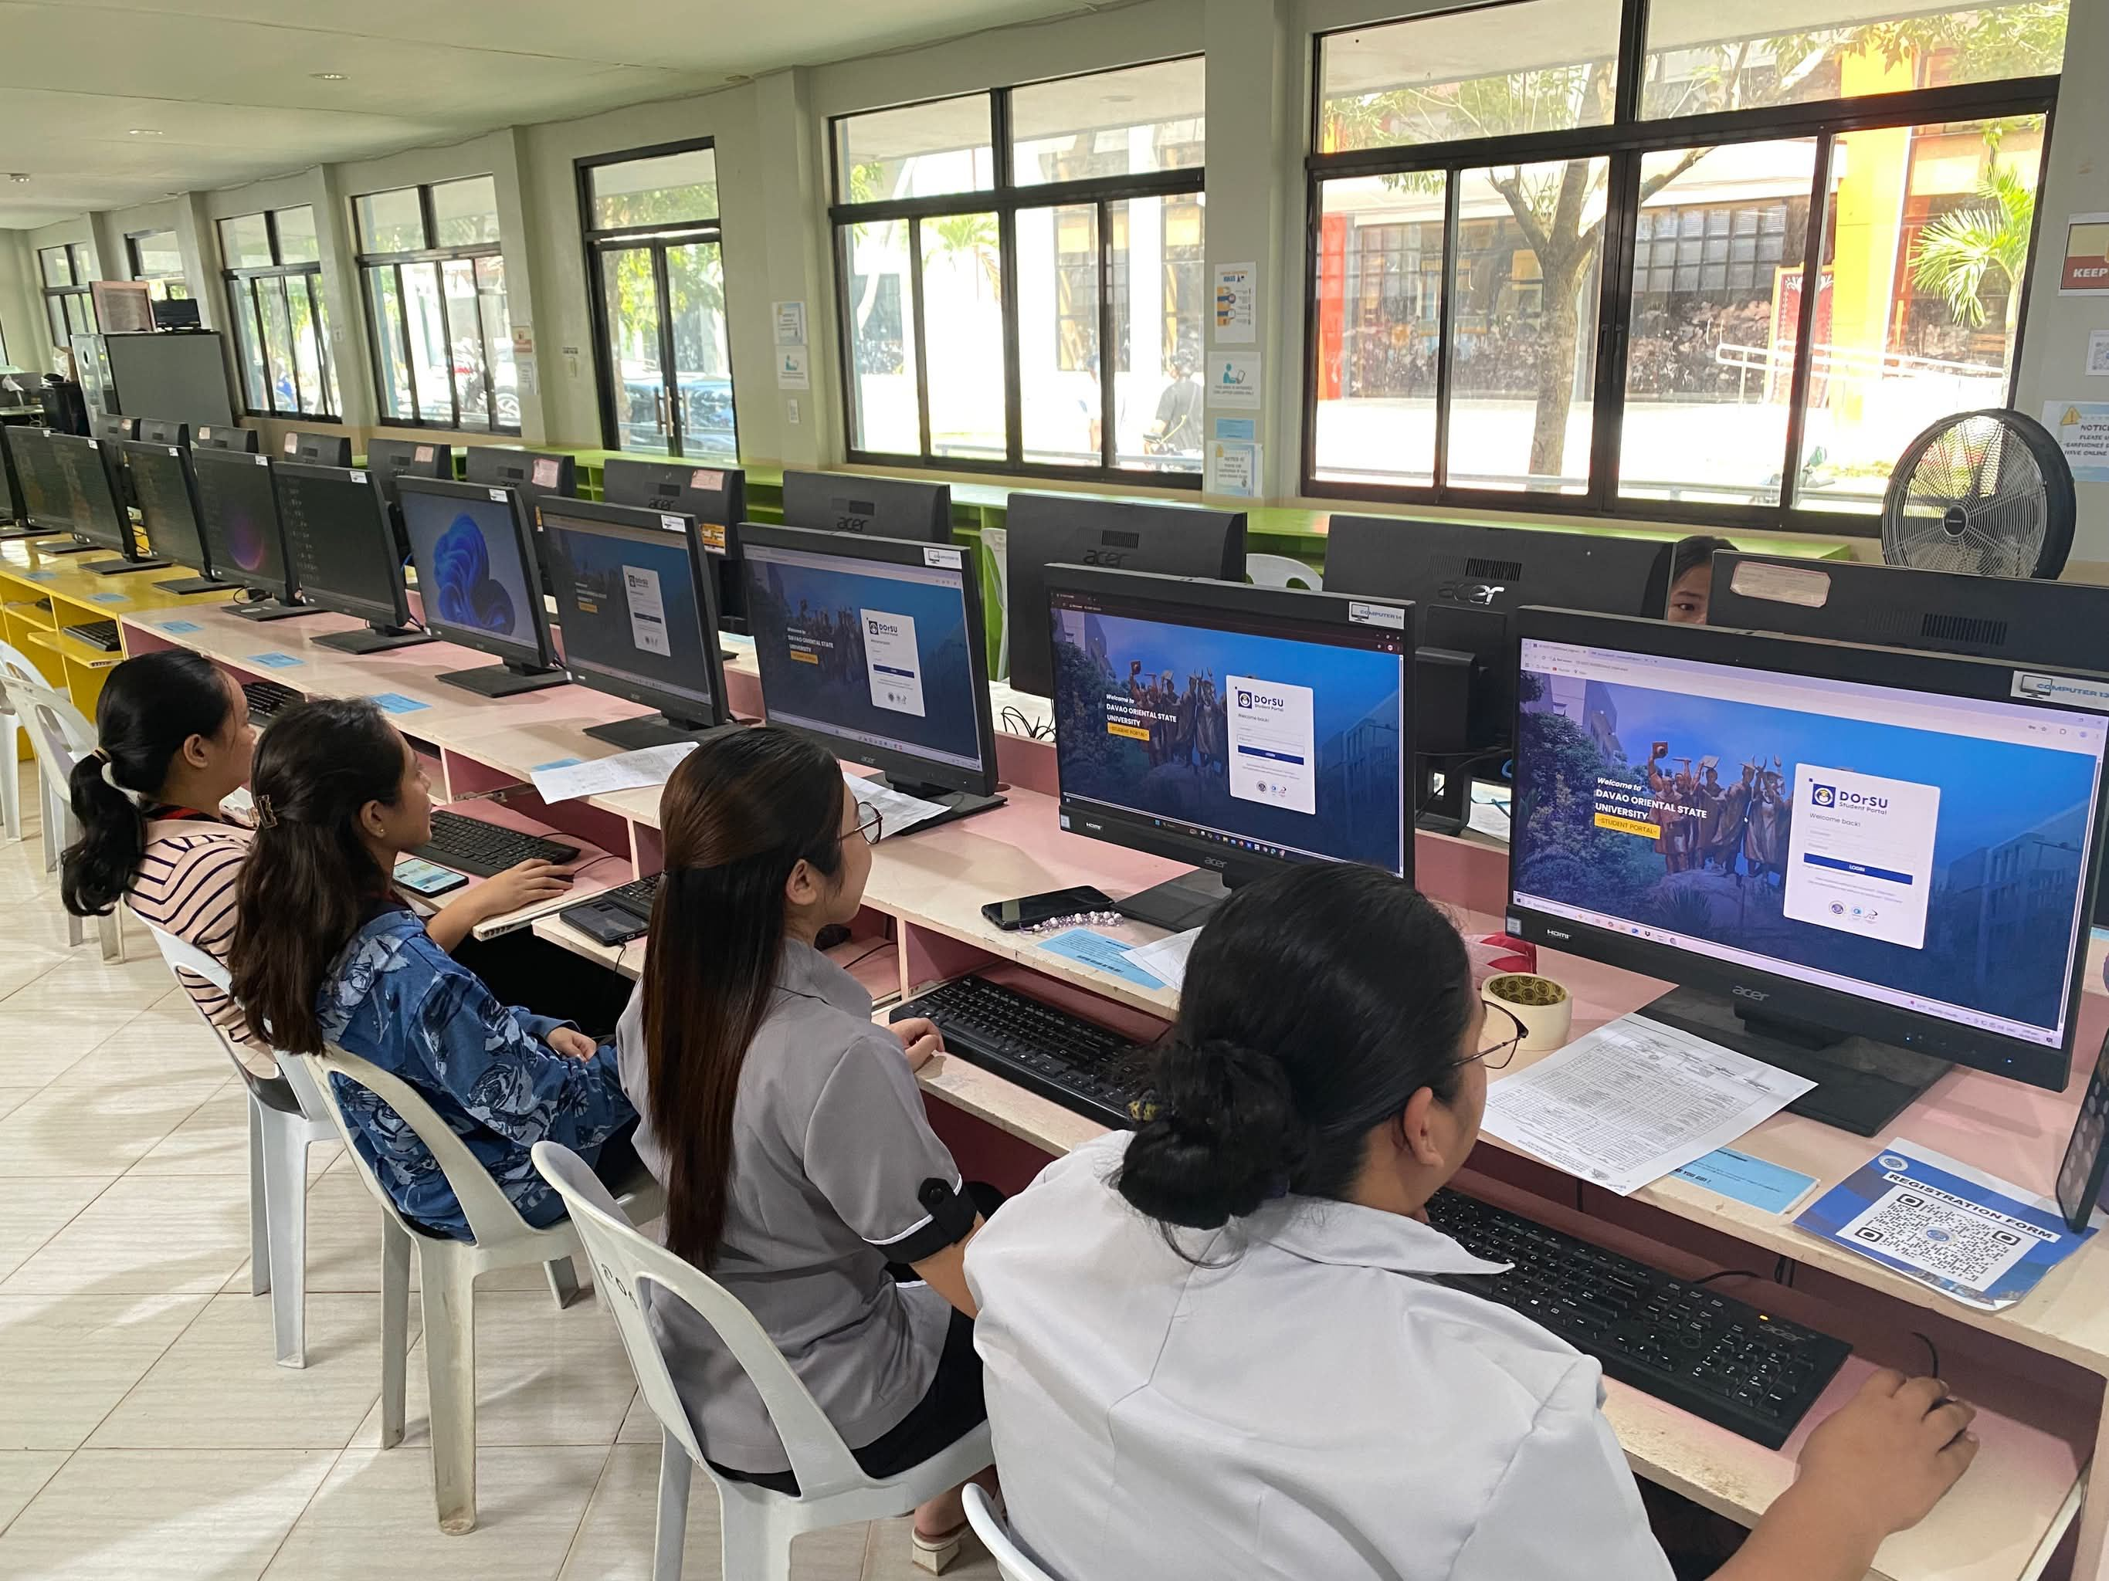
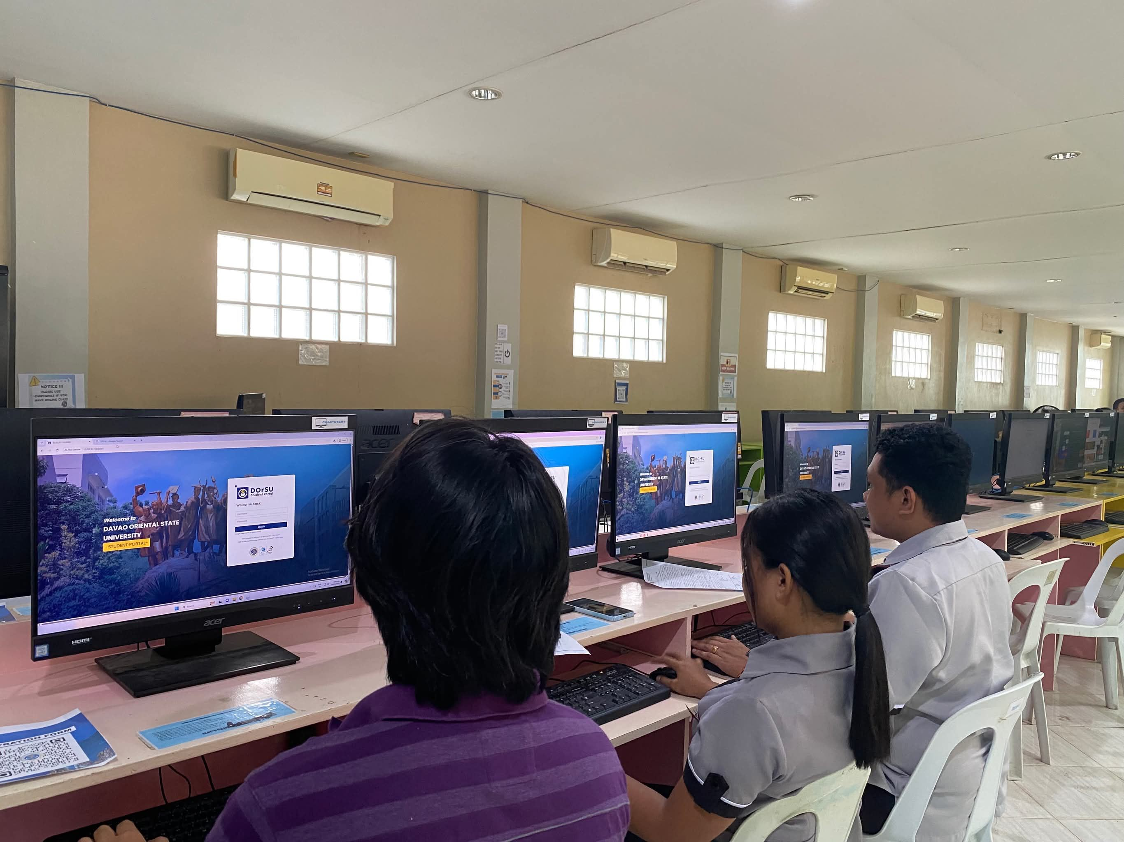
OJT Outputs (by group and individual)
We are the students of different courses behind the Training and Testing of DOrSU ISMS Phase 1 and 2. We also did a user testing before they conducted the Phase 1 and 2 to check if the ISMS still has bugs and errors and also to ensure that the system runs smoothly. We are assigned with different roles during the user testing (students and admins).

Slide 18
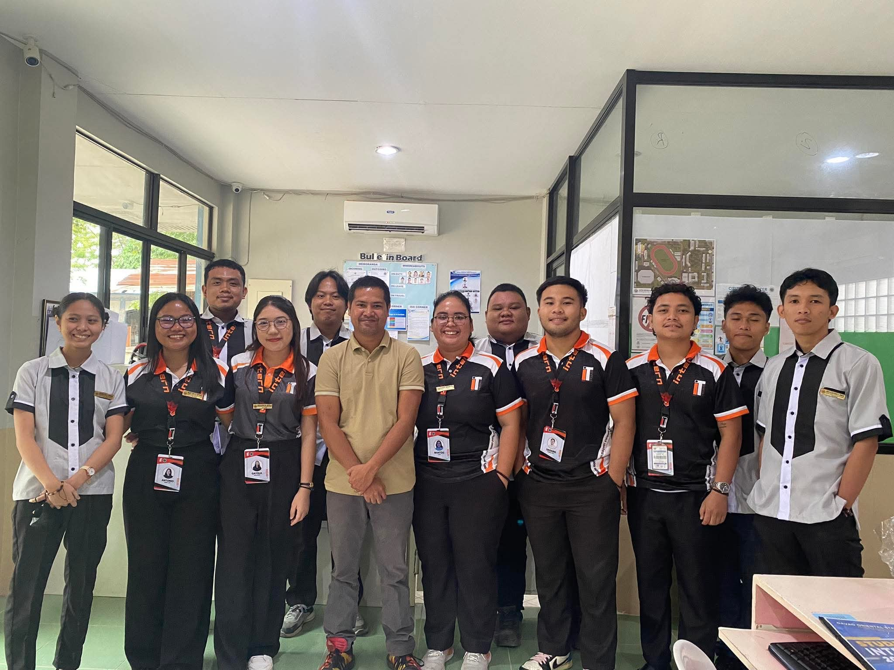
Pictorials
DEPLOYMENT

Slide 19
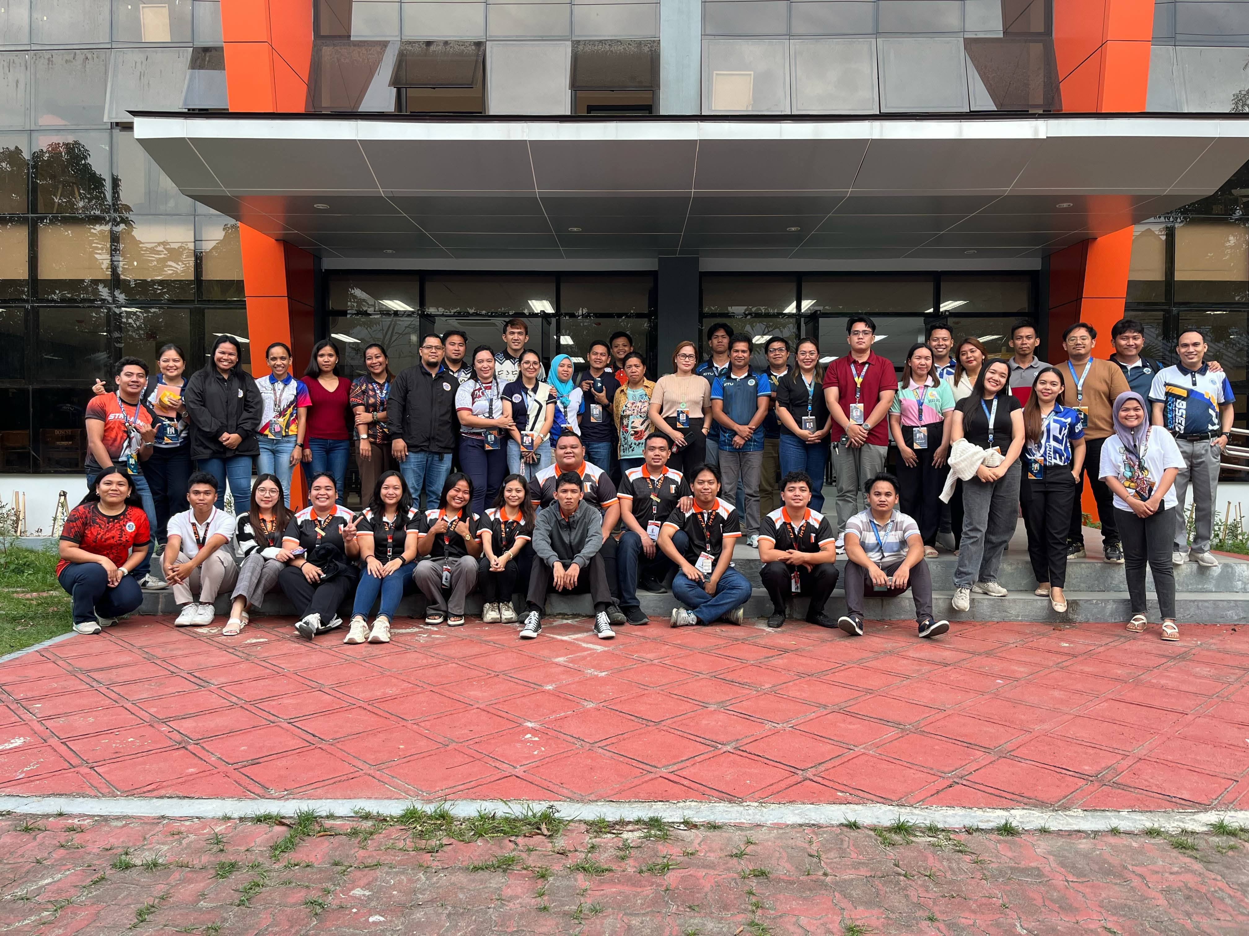
Pictorials
Phase 2: Training and Testing of ISMS

Slide 20
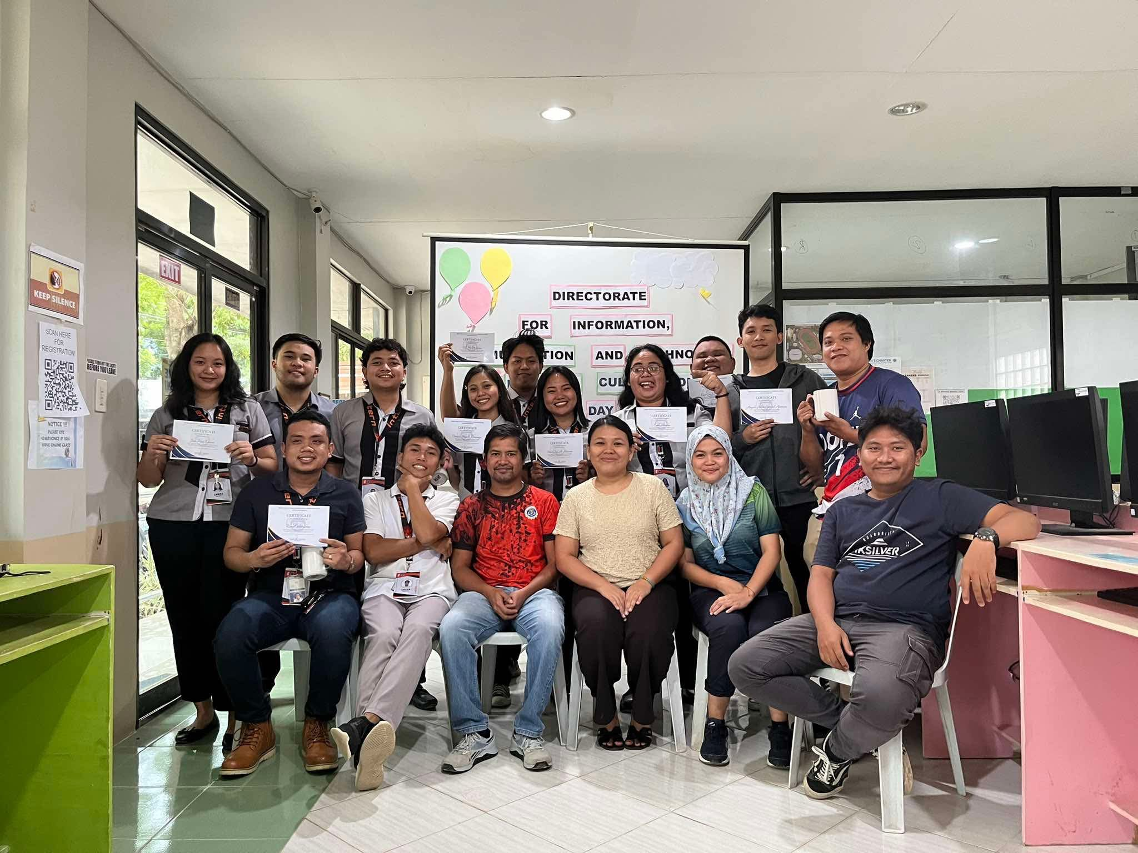
Pictorials
CLOSING (with DICT TEAM)

Slide 21
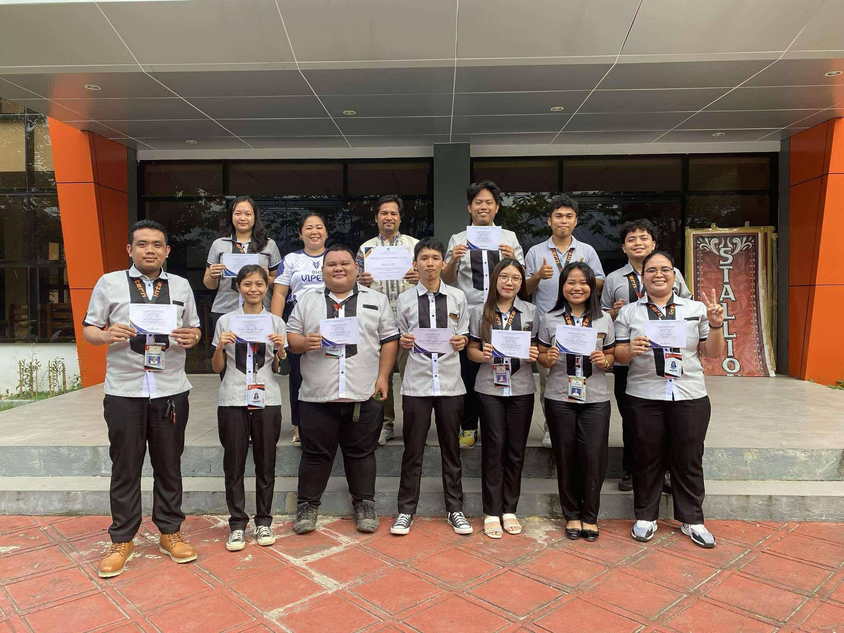
Pictorials
CLOSING

Slide 22
Challenges Encountered
Antonio: Socializing/Communication is always been my greatest challenge, and since the office is consists of numerous work force, I have been obliged to connect with them. Another challenge to me is the fact that is my first time on the actual working environment as an IT skilled staff. The technical challenges weren’t that much of matter to me as a whole. Rather, the changes of routine from student to Intern puts me in a new situation thus requires some changes too.
Aparicio: The main challenge I have encountered so far has been my lack of self-confidence and hesitation to voice my ideas.

Slide 23
Challenges Encountered
Colita: One of the challenges I encountered during my internship at the DOrSU DICT Office (ICTU) was adapting to new systems and tools that I had limited experience with.
Domingo: Still bashful in communicating with the employer over some important matter and I find it hard to explain to some students (while catering their request for institutional emails) in simple terms without relying too much on IT technical language.

Slide 24
Challenges Encountered
Enriquez: Throughout the experience, I encountered several challenges, such as troubleshooting unexpected technical errors during configuration, managing time efficiently while handling multiple tasks, and adapting quickly to new tools and technologies. Communicating technical issues clearly to non-technical stakeholders was also a challenge that helped me improve my ability to convey complex information in simpler terms.
Gayola: Being shy, sometimes being hesitant to voice out my concerns and thoughts, struggle of using unfamiliar software/s for the first time, and facing a learning curve.

Slide 25
Challenges Encountered
Lawas: I still feel a bit shy when discussing important matters with my employer, and I sometimes struggle to explain technical requests—like institutional email setups—to students in simple, easy-to-understand language without relying too much on IT jargon. Improving how I communicate in these situations is something I’m actively working on.
Lore: During my on-the-job training, I was assigned tasks like repairing printers, reformatting and setting up computers, and developing a document tracking system. Challenges included the lack of available parts and tools, unfamiliar printer models, and troubleshooting steps. I had to research user manuals and troubleshoot issues, and back up important data. Balancing development work with other technical duties was challenging, as we were unfamiliar with ASP DotNet. Despite these challenges, they helped me grow both technically and professionally, providing a better understanding of real-world IT work.

Slide 26
Challenges Encountered
Mantog: Fear of making mistakes.
Sasiang: I was tasked with fixing printers, reformatting and configuring computers, and creating a document tracking system during my on-the-job training. Unfamiliar printer models, troubleshooting procedures, and a shortage of parts and tools were obstacles. I had to look up user manuals, solve problems, and make backups of crucial information. Because we were not experienced with ASP DotNet, it was difficult to balance development work with other technical responsibilities. Despite these difficulties, they aided in my professional and technical development and improved my comprehension of actual IT work.

Slide 27
Challenges Encountered
Superalez: The hardest thing for me to deal with is having poor memory. Data entries and information are accumulating, leaving me unsure of where to begin or what I should address first. I let my short fuse to get in the way of my work as well, which led to poor progress on whatever assignments my supervisor gave me.
Venturina: I experienced personal adjustments in a professional work environment, particularly in communication and interpersonal interaction. I realized the importance of collaboration and open communication in the workplace. Transitioning from a student to an IT intern was a significant shift, as I had to adapt quickly to new expectations and productivity measures. I also learned to manage time, communicate clearly, and contribute actively to the organization's goals.

Slide 28
Learning Insights
Antonio: With the majority of my time spent working with the office, there are a lot of things that learned and developed throughout the journey. Majority of clerical tasks are used to be hard as I thought of them in the past, but now that I am given a chance to experience it personally, I can confidently say that I am now a more capable IT support. We were given the tasks to test (user testing) a particular system/application, and I gained a lot of lessons while doing the job.
Aparicio: Since the resumption of face-to-face classes, I have gained substantial experience at the ICTU Office. Beginning as a volunteer and later transitioning to an intern, I have had the opportunity to apply my knowledge in a professional setting, contributing to technical tasks, quality assurance, and various administrative duties.

Slide 29
Learning Insights
Colita: As an IT student intern assigned to the DOrSU DICT Office (ICTU), I gained valuable experience in managing tasks effectively, which deepened my understanding of real-world IT operations. This opportunity also enhanced my technical and communication skills as I collaborated with experienced professionals.
Domingo: I learned how to utilize my knowledge in a real-work setting such as doing network cabling and configuration, and looking for potential bugs while user testing of a developed system.

Slide 30
Learning Insights
Enriquez: I applied my knowledge in a real-world work environment by engaging in tasks such as network cabling, system configuration, and identifying potential bugs during user testing of a developed system. As a future employee, I also demonstrated strong interpersonal skills by effectively communicating my ideas with my employer and contributing to the system’s development process.
Gayola: I learned about the importance of professionalism in an actual work setting, exposure to different kinds of software/s, time management, teamwork and collaboration, and being more responsible.

Slide 31
Learning Insights
Lawas: I learned how to apply my knowledge in a practical work environment, including tasks like network cabling, configuration, and spotting potential bugs during user testing of a system. This hands-on experience helped me connect theory with real-world IT challenges.
Lore: During my On-the-Job Training (OJT), I gained valuable insights into how theoretical concepts from school are applied in real-world IT environments. I improved my technical skills, particularly in coding and hardware troubleshooting, through hands-on tasks and guided mentorship. I also developed a better understanding of IT system maintenance and repair processes within a professional setting. Facing real challenges helped me enhance my problem-solving abilities, and collaborating with experienced technicians taught me the importance of teamwork, communication, and adaptability in the workplace.

Slide 32
Learning Insights
Mantog: I learned the importance of teamwork and collaboration in a work setting.
Sasiang: I learned a lot about how academic theories are implemented in practical IT settings throughout my On-the-Job Training (OJT). Through practical exercises and supervised mentoring, I enhanced my technical abilities, especially in coding and hardware debugging. Additionally, I gained a deeper comprehension of the procedures involved in professional IT system maintenance and repair. Working with seasoned specialists taught me the value of cooperation, communication, and flexibility in the business, and confronting actual problems improved my problem-solving skills.

Slide 33
Learning Insights
Superalez: I gained knowledge on how to manage crucial circumstances where concentration and mental clarity are essential. Additionally, I learnt the fundamentals of data entry and troubleshooting system where I work. Finally, responding to many requests from various departments inside the institution has improved my communication abilities.
Venturina: During my office work, I gained valuable knowledge and improved professional skills. Initially, clerical tasks were challenging, but direct handling improved my comfort and efficiency. One significant experience was conducting user testing for a specific system or application, deepening my understanding of technical aspects and increasing my confidence as an IT support staff. This journey contributed significantly to my personal and professional development.

